Slide 1
SOIL PROPERTIES ESTIMATION USING HYPERSPECTRAL REFLECTANCE DATA
SUBMITTED TO:
Dr. Paresh Rathod,
ANAND AGRICULTURE UNIVERSITY
SUBMITTED BY:
SMIT BHUVA(202319027)
DEEP RABADIYA(202319029)
JATIN SATANI(202319021)
HEMANTH B S(202319009)

Slide 2
Introduction
Soil properties such as pH, electrical conductivity (EC), organic carbon (OC), and nutrient levels (e.g., Cu, Mn, Zn, Fe, K, P2O5, S) are crucial for agricultural productivity and environmental sustainability.
The use of hyperspectral imaging technology allows for the detailed analysis of soil properties over large areas, providing a non-destructive method to gather data that can enhance soil management practices.
This research focuses on estimating various soil properties using hyperspectral reflectance data, aiming to create accurate maps for better agricultural decision-making in the Anand district.

Slide 3
Objectives
Estimate Soil Properties: To utilize hyperspectral imaging to estimate key soil properties, including pH, EC, OC, and essential nutrients, which are vital for crop growth and soil health.
Develop Predictive Models: To apply machine learning techniques, specifically Random Forest and Multilayer Perceptron (MLP) regressors, to develop predictive models that can accurately assess soil characteristics from hyperspectral data.
Enhance Agricultural Practices: To provide actionable insights and maps based on the estimated soil properties, facilitating improved agricultural practices and resource management in the studied region.

Slide 4
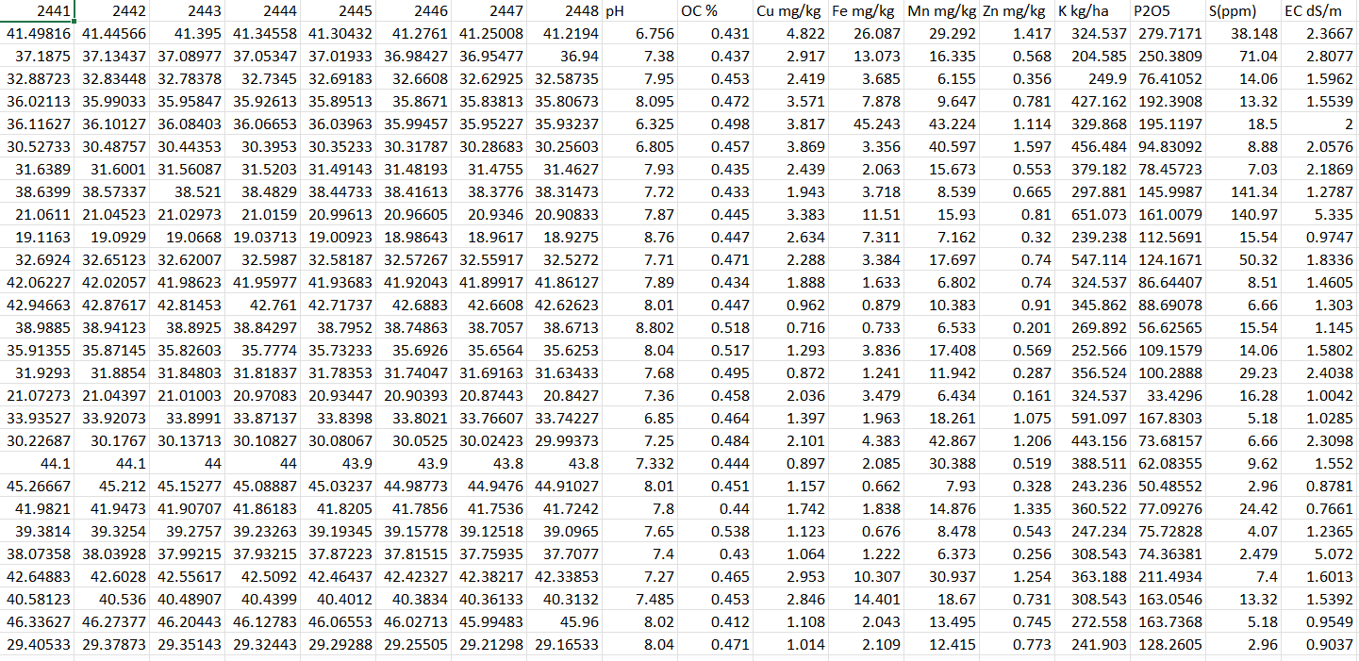
ABOUT DATA

Slide 5
VARIABLES
Independent Variables / Features:
HYPERSPECTRAL IMAGE WITH 2100 BANDS AND 500 GROUND TRUTH POINTS
Dependent Variable / Target:
pH, EC, OC, Cu, Mn, Zn, Fe, K, P2O5, S

Slide 6
METHODOLOGIES
STEP 2
Understand The Problem Statement
Data Collection
Data Preparation
STEP 1
STEP 3
STEP 5
Final Result
Evaluation of
Model
Training The Model
STEP 6
STEP 4

Slide 7
Data Preparation
Here, we have hyperspectral reflectance data from 350 – 2448 nm along with soil chemistry data.
Firstly, we tried correlation analysis for any one soil chemistry with those hyperspectral data; but we got maximum of 31% correlation among whole dataset for any of soil chemistry data.
So, we used Standard Normal Variate(SNV).
It found effective in this dataset for training ML models.

Slide 8
How Standard Normal Variate (SNV) preprocessing works?
Mean Centering: Each spectrum is adjusted by subtracting the mean of the spectrum from each data point. This centers the data around zero, removing any offset.
Scaling by Standard Deviation: After mean centering, each data point is divided by the standard deviation of the spectrum. This step normalizes the data, ensuring that the variance is consistent across all spectra.
Result: The processed spectra have a mean of zero and a standard deviation of one, which helps in reducing the effects of scatter and other physical variations, making the data more suitable for further analysis and modeling.

Slide 9
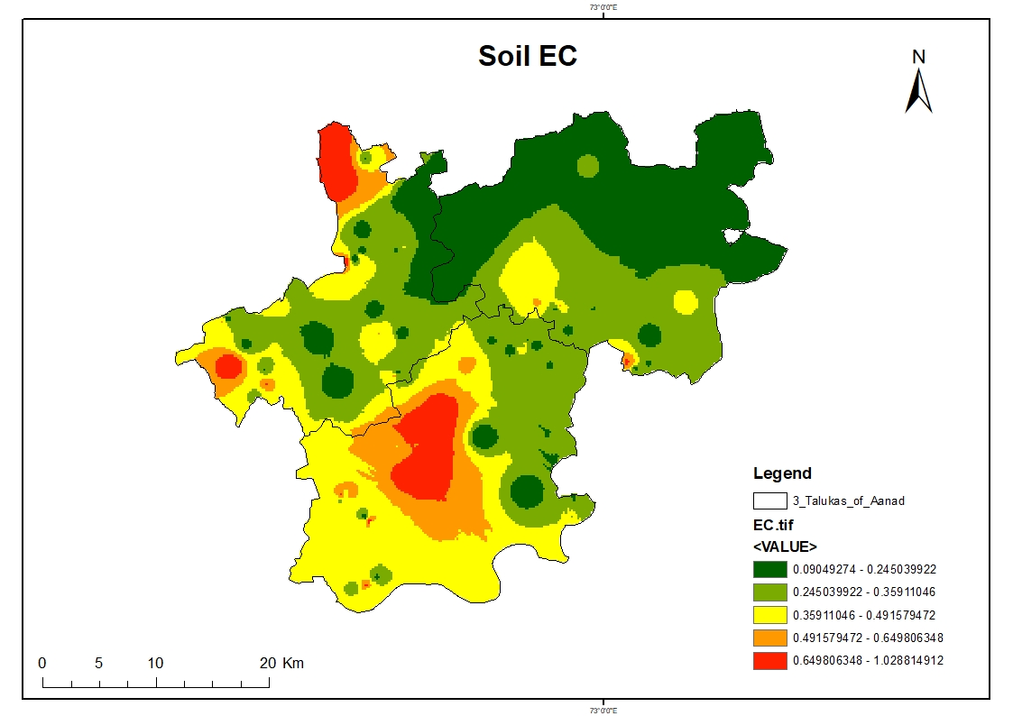
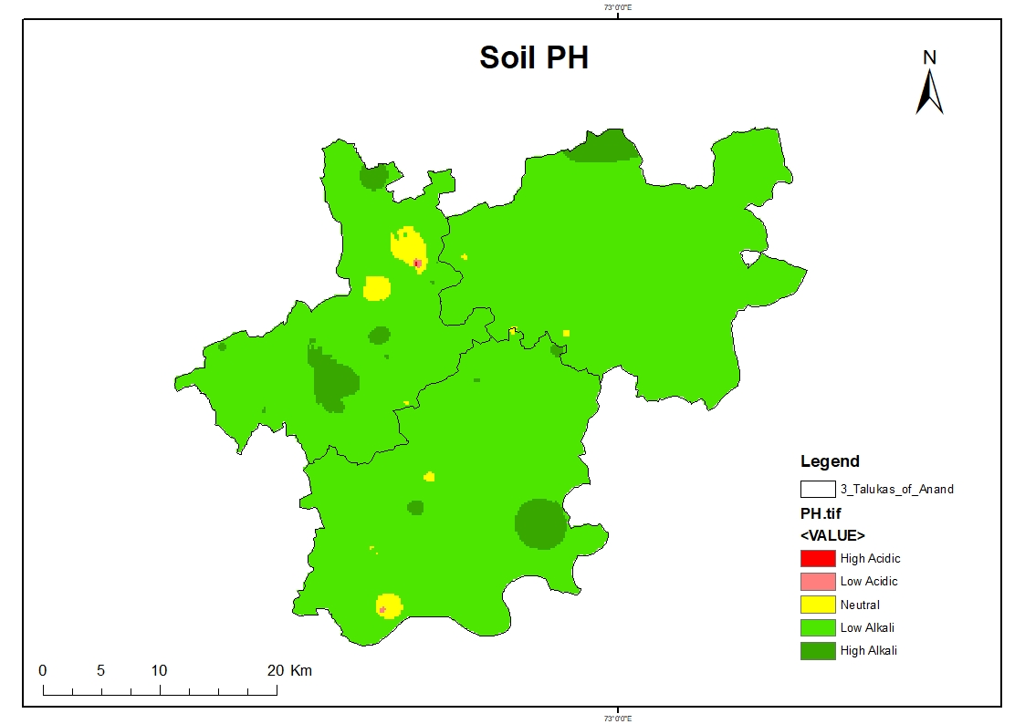
DATA ANALYSIS
Here, we provided maps of the soil chemistry parameters and nutrients for three Talukas of Anand district (Anand, Borsad and Petlad).
Very High: 0.09049274 - 0.245039922
High: 0.245039922 0.35911046
Medium: 0.35911046-0.491579472
Low: 0.491579472 - 0.649806348
Very Low: 0649806348 - 1.028814912
High Acidic: 0.09049274 - 0.245039922
Low acidic: 0.245039922 0.35911046
Neutral: 0.35911046-0.491579472
Low alkali: 0.491579472 - 0.649806348
High alkali: 0649806348 - 1.028814912

Slide 10
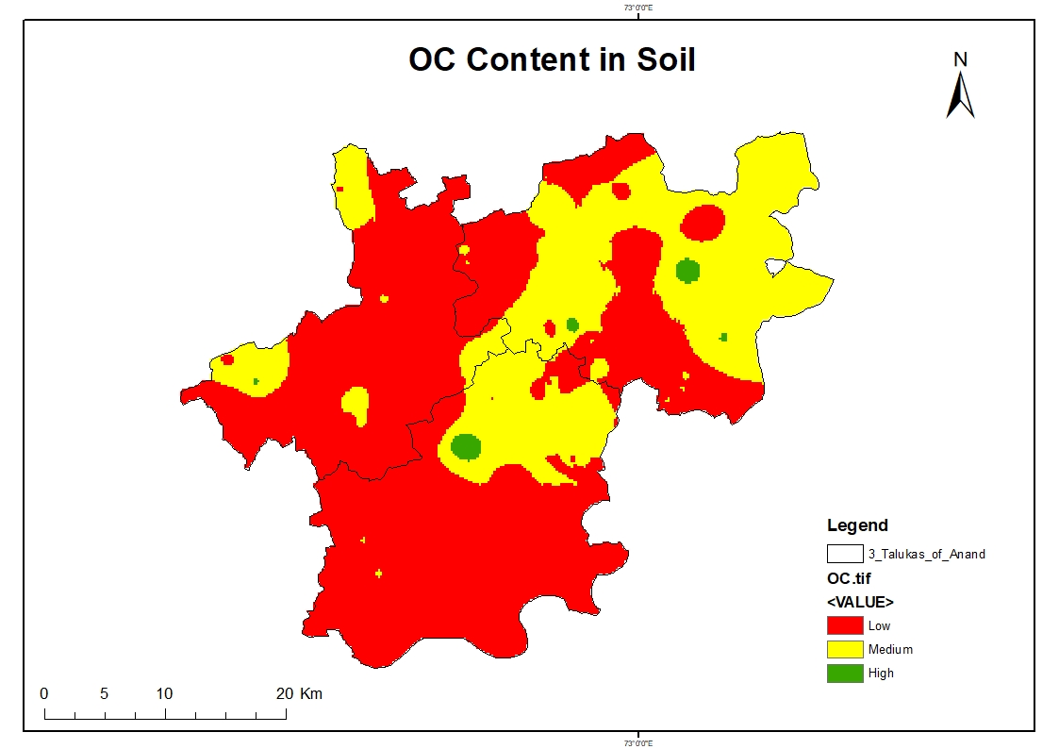
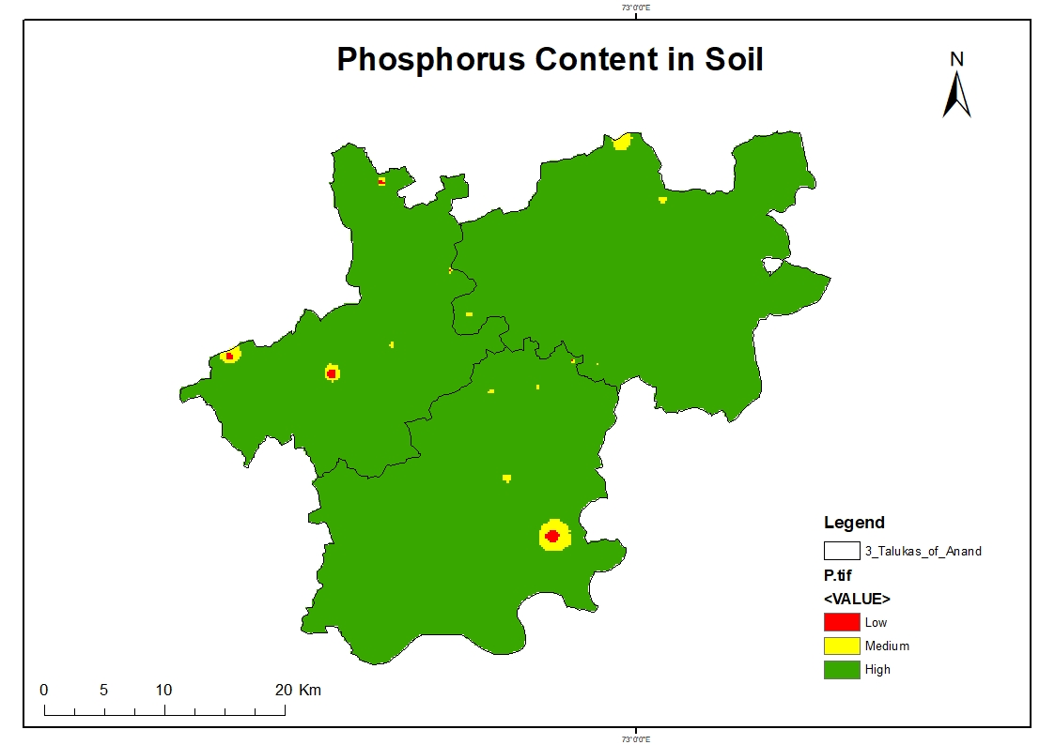
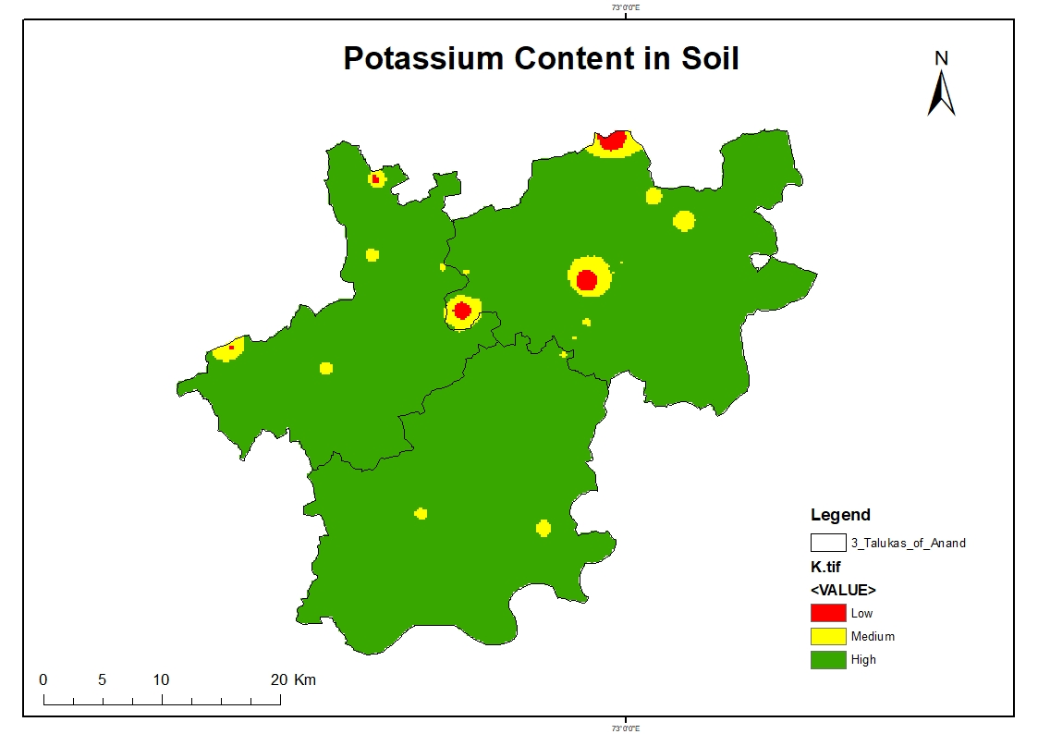
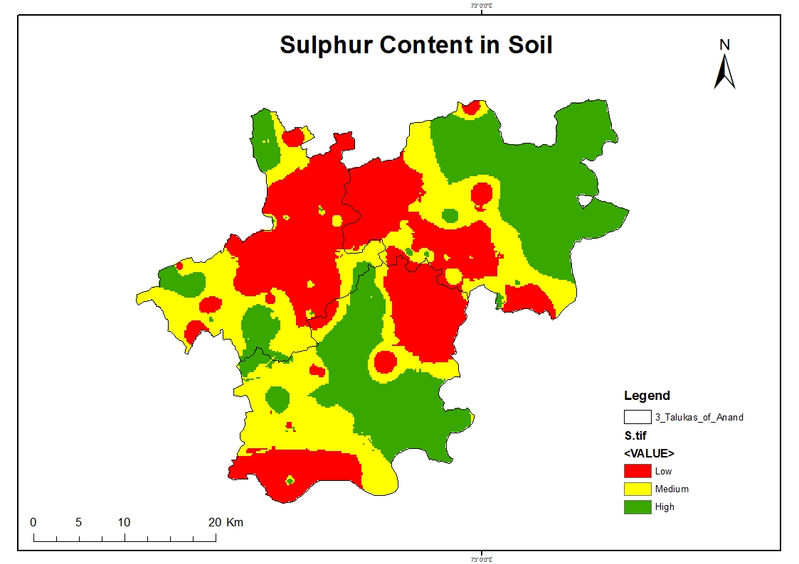
OC %
High: > 0.75%
Medium: 0.5 – 0.75 %
Low: <0.5%
P2O5
High: > 22 kg/ha
Medium: 11 – 22 kg/ha
Low: <11 kg/ha
K
High: > 280 kg/ha
Medium: 180 – 280 kg/ha
Low: <180 kg/ha
S
High: > 15 ppm
Medium: 10 – 15 ppm
Low: <10 ppm

Slide 11
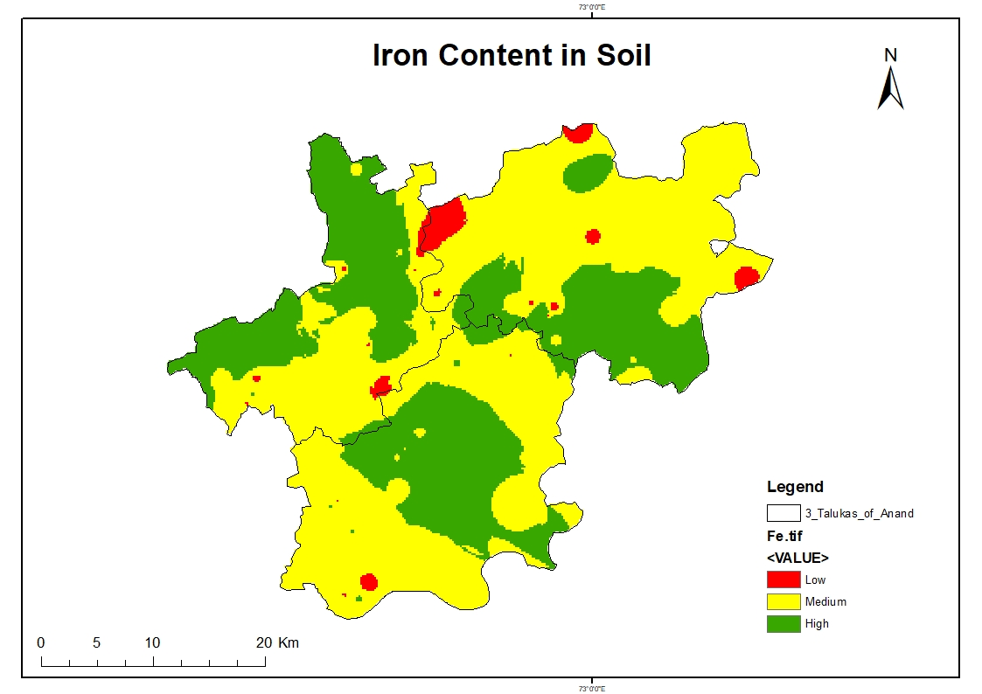
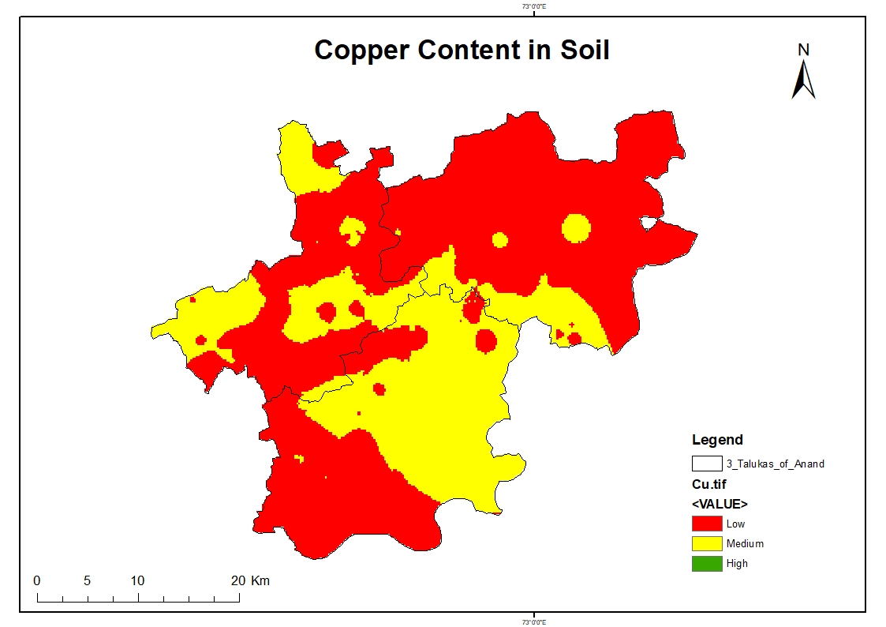
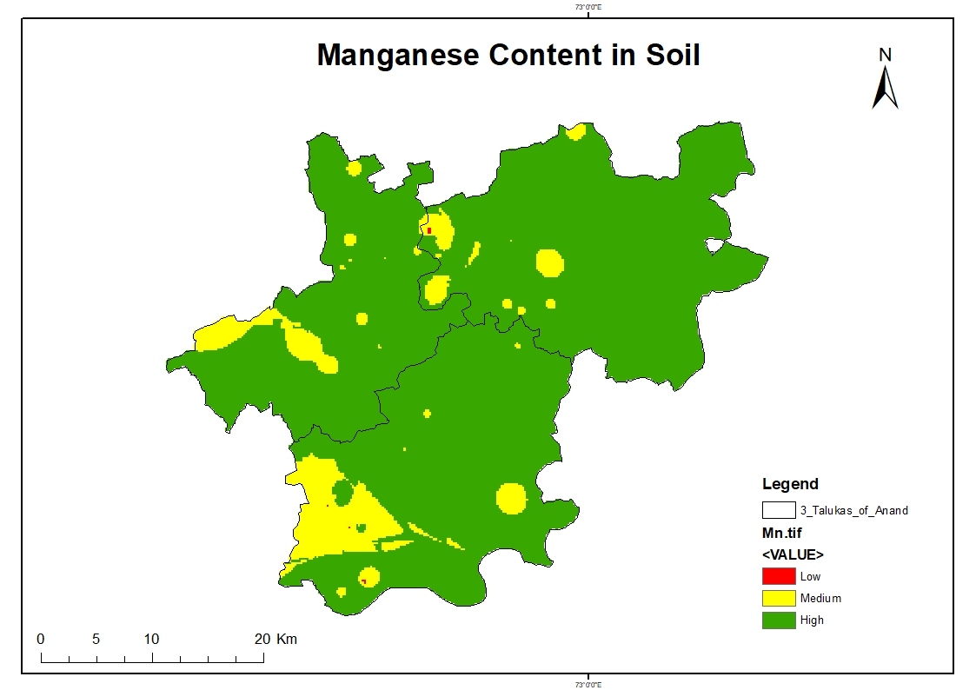
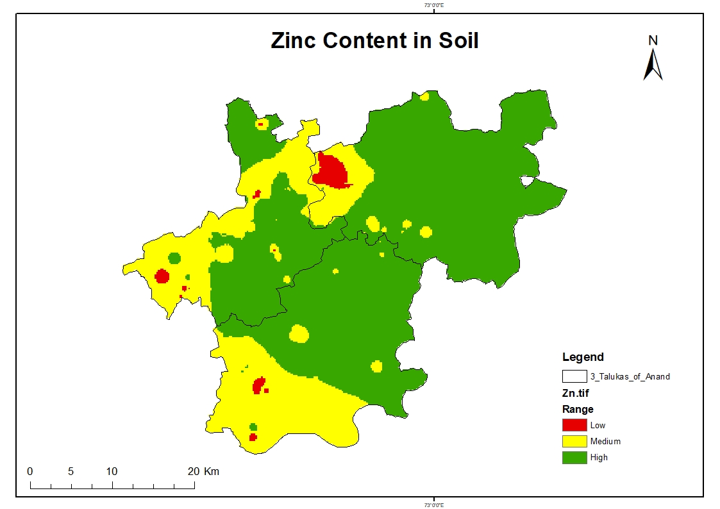
Fe
High: > 10 mg/kg
Medium: 5 – 10 mg/kg
Low: < 05 mg/kg
Cu
High: > 5 mg/kg
Medium: 2.5 – 5.0 mg/kg
Low: < 2.5 mg/kg
Mn
High: > 10 mg/kg
Medium: 5 – 10 mg/kg
Low: < 05 mg/kg
Zn
High: > 1 mg/kg
Medium: 0.5 – 1 mg/kg
Low: <0.5 mg/kg

Slide 12
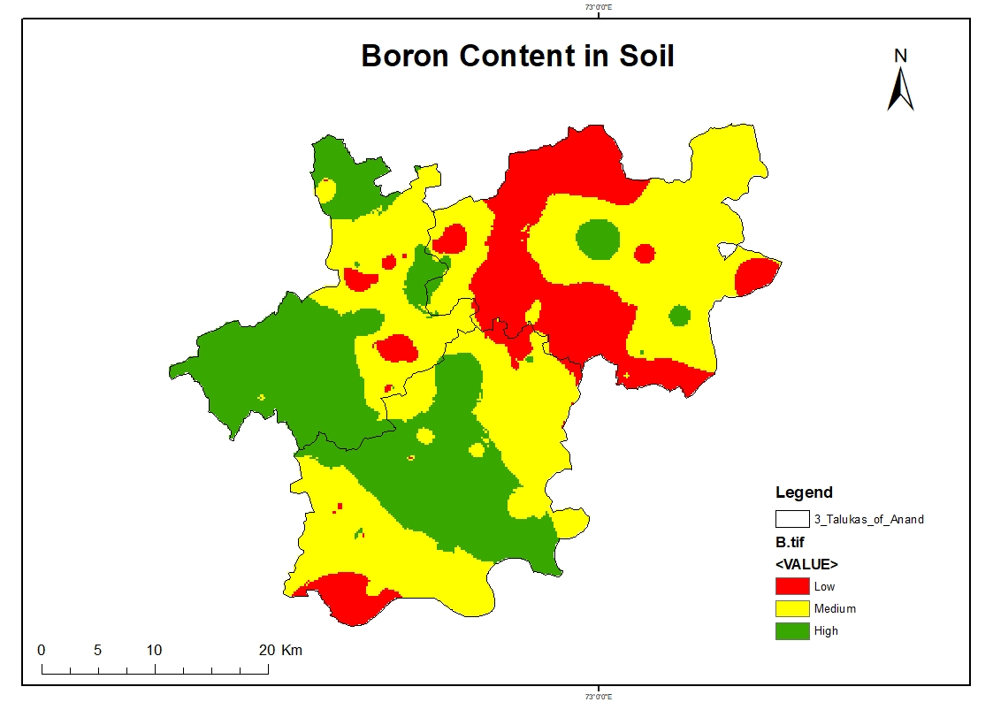
B
High: > 1 mg/kg
Medium: 0.5 – 1 mg/kg
Low: <0.5 mg/kg

Slide 13
OBSERVATION
 | RANDOM FOREST |  | MLP REGRESSOR
SOIL PROPERTIES | TRAINING ACCURACY | TESTING ACCURACY | TRAINING ACCURACY | TESTING ACCURACY
pH | 0.93 | 0.57 | 0.61 | 0.41
EC | 0.89 | 0.17 | 0.55 | 0.01
OC | 0.91 | 0.39 | 0.32 | 0.08
Cu | 0.93 | 0.46 | 0.66 | 0.49
Mn | 0.91 | 0.45 | 0.47 | 0.20
Zn | 0.85 | 0.46 | 0.64 | 0.16
Fe | 0.93 | 0.47 | 0.66 | 0.49
K | 0.92 | 0.33 | 0.65 | -0.26
P2O5 | 0.92 | 0.52 | 0.65 | 0.51
S | 0.92 | -0.12 | 0.72 | -0.38

Slide 14
CONCLUSION
Random Forest
Training Accuracy: Generally high across all properties, ranging from 0.85 to 0.93.
Testing Accuracy: Significantly lower than training accuracy, indicating potential overfitting. The highest testing accuracy is for pH (0.57) and P2O5 (0.52), while the lowest is for S (-0.12).
Multilayer Perceptron(MLP) Regressor
Training Accuracy: Lower than Random Forest, ranging from 0.32 to 0.72.
Testing Accuracy: Also lower than Random Forest, with some negative values indicating poor generalization. The highest testing accuracy is for Cu and Fe (0.49), while the lowest is for S (-0.38).
Overall Conclusion
Random Forest: Performs better in terms of training accuracy but suffers from overfitting, as indicated by the drop in testing accuracy.
MLP Regressor: Shows lower training and testing accuracy overall, with some properties having very poor testing performance.

Slide 15
Thank You

